Slide 3
RETAIL SHELVING SYSTEM

Slide 4
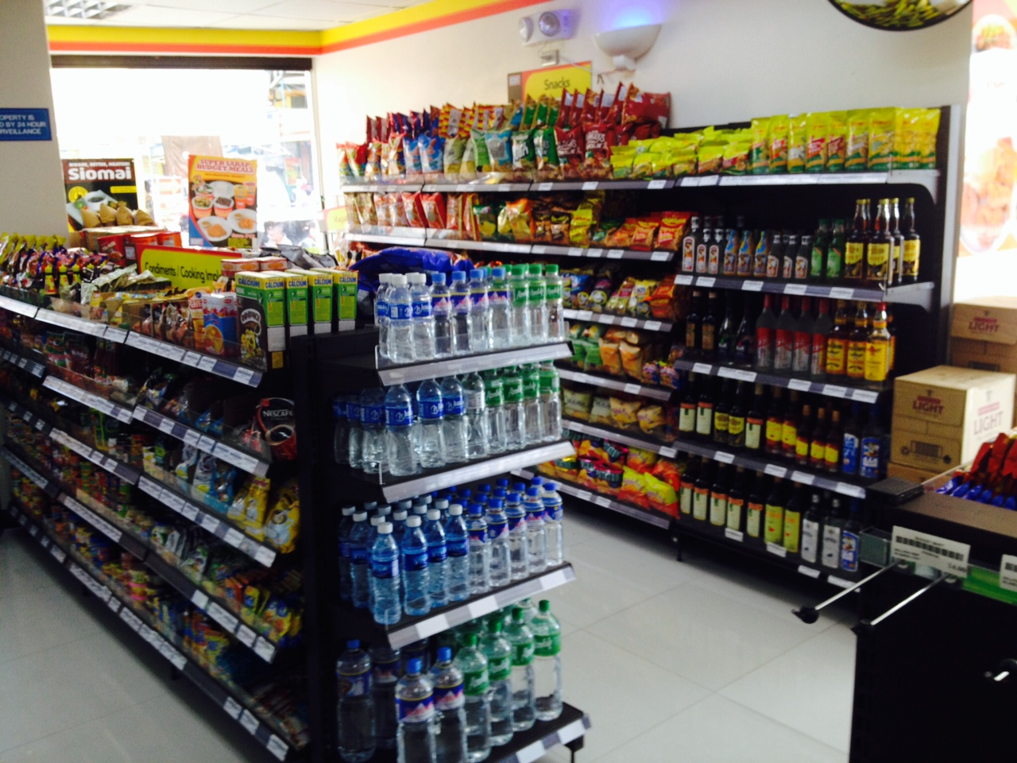
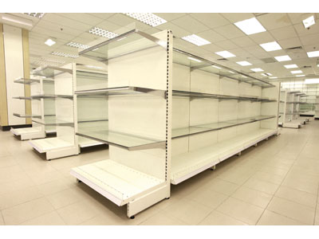
Retail Shelving System
MOEM gondolas are designed for all supermarkets, grocery stores, hardware shops and etc.
Composed of formulated industrial steel which is designed thicker than conventional gondolas for greater weight capacity

Slide 5
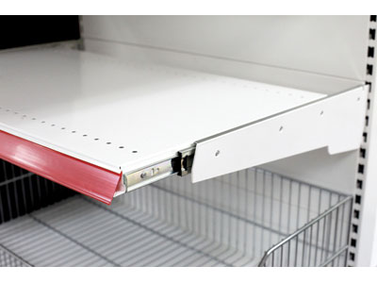
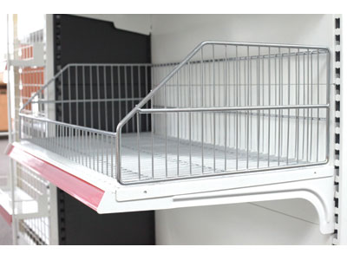
Retail Shelving System
Each shelf has a loading capacity of 130kg
350kg capacity on the bottom shelf

Slide 6
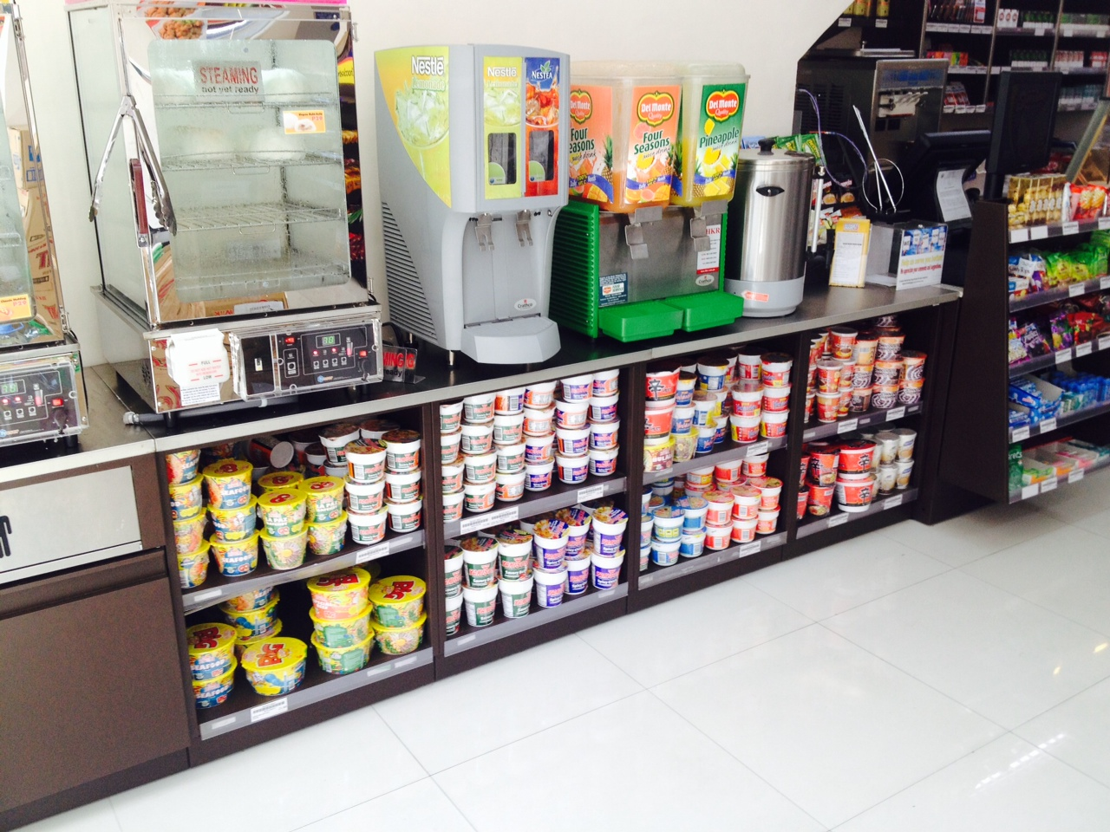
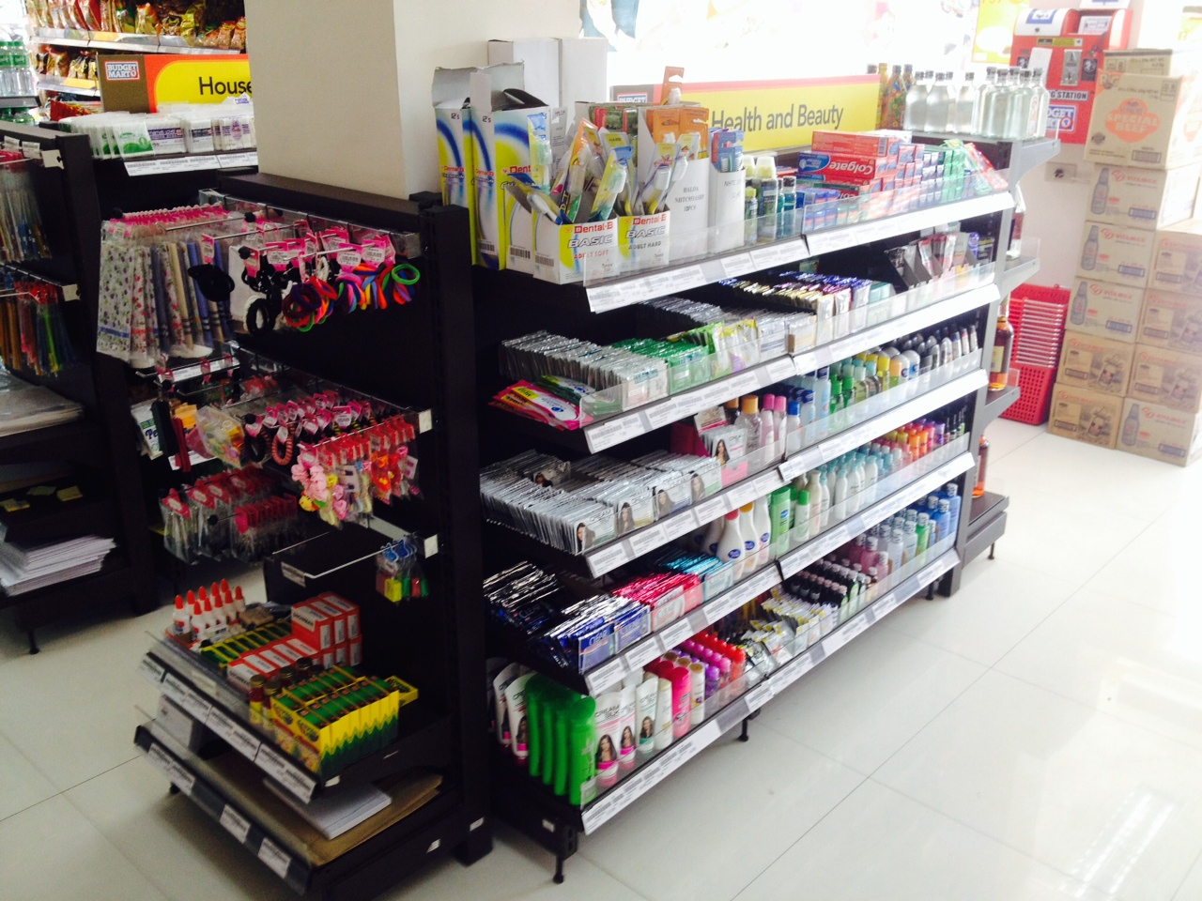
Retail Shelving System
All modular counters and gondolas comprise simple components that are assembled without special tools.
Fully powder coated

Slide 7
FIRE RESISTANT CABINETS AND SAFES

Slide 8
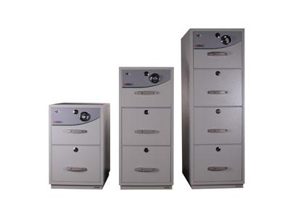
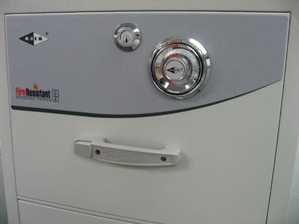
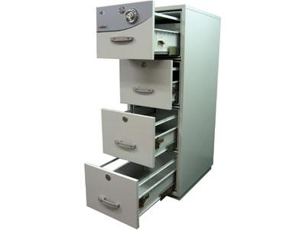
Fire Resistant Cabinets
Special formulated fire resistant barrier material using Electro-Galvanized steel
Press button handle
Locking system
Heavy duty metal railing
Shock absorbing plinth
Epoxy powder coated

Slide 9
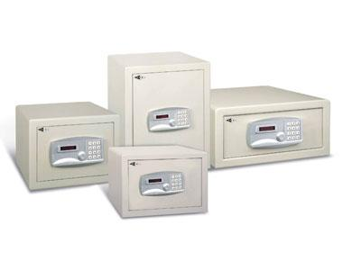
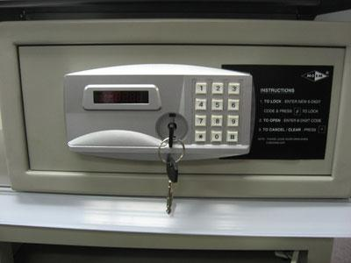
Electronic Safe
Fire endurance test was conducted in Europe in accordance to test specification NT-Fire 017 (edition 2) by SP Technical Research Institute of Sweden. The furnace was heated up according to standard time temperature curve in accordance to SIS 02 48 20 (up to 1000°C). The maximum temperature rise (cabinet- internal) after 60 minutes was 114°C.

Slide 10
MODULAR SYSTEM

Slide 11
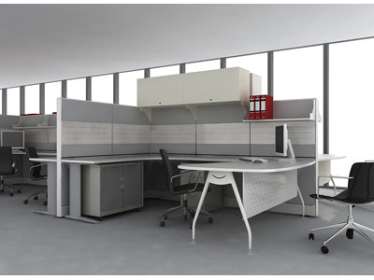
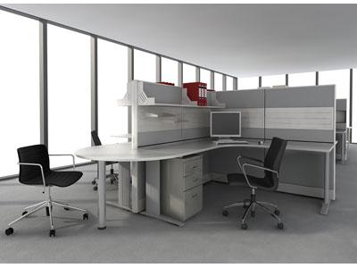
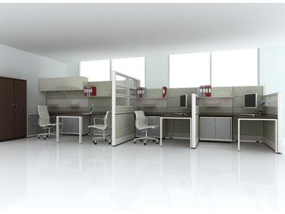
Modular System
Multifaceted and Spontaneous
Teritorial and Concentrated
Notes:
OPTIMIZING efficient use of WORKSURFACES through MULTI-TASKING with various CO-WORKERS yet retaining INDIVIDUAL’s COMFORT and PERSONAL SPACE
Transformation to include MANAGERIAL SPACE IN PAIRS with SUBORDINATE WORKSPACE to form departments, speeding concentrated interaction and knowledge generation.

Slide 12
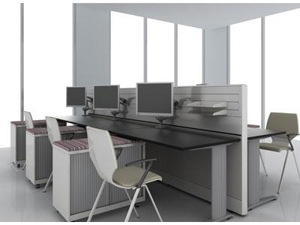
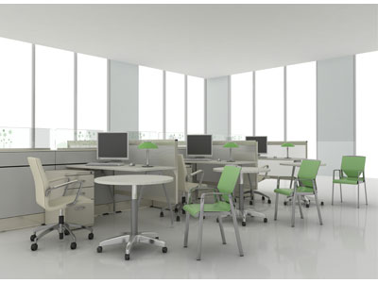
Modular System
Enhance Teaming
Open Planning
Notes:
LOW RAIL TILES promotes INTERACTION and COLLABORATION among workmates while seated without the interference of congested worksurfaces
Defining INDIVIDUAL WORKSPACE from the overall work environment and to MINIMIZE VISUAL DISTRACTIONS by providing a balance between privacy and contact

Slide 13
MOBILE STORAGE

Slide 14
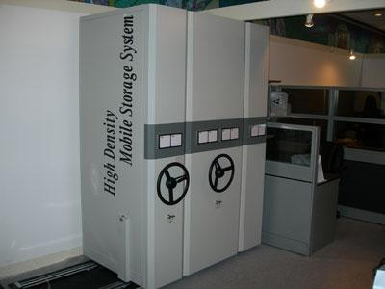
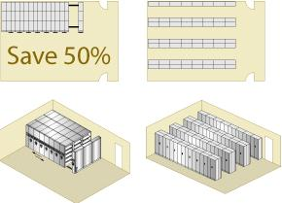
Mobile Storage
Modernized Office Look
STANDARD SPECS:
2082mmH x 914mmW x 772mmD
Loading Capacity (per Bay): 250kg
Space Savers
Notes:
Anti-Tilt, Safety Lock, Easy Steering Wheel, Adjustable Shelves, Powdered Epoxy Coating
Long Term Efficiency
Create Space for Alternative usage
Easy handling and management of storage materials

Slide 15
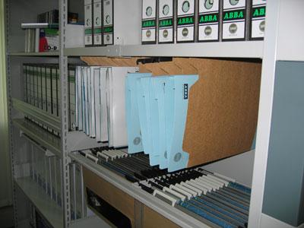
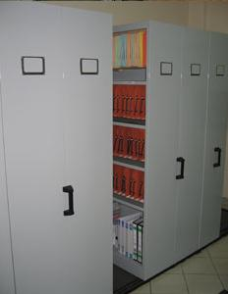
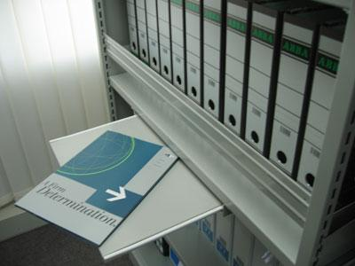
Mobile Storage
Hanging File Storage
Horizontal Records System
Spare Parts Cabinet
Notes:
Mobile Storage Systems provides a solution to your storage needs and increase storage efficiency with systematic filing and retrieval of storage materials.
Ideal for Records, Files, CDs, Hospital supplies, Warehouse storage, spare parts, shoes and personal storage

Slide 16
OFFICE SUPPLIES

Slide 17
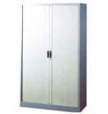
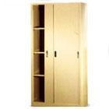
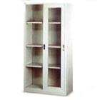
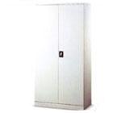
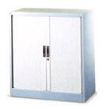
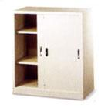
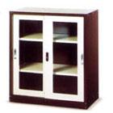
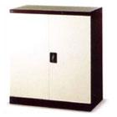
Steel Cupboards

Slide 18
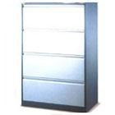
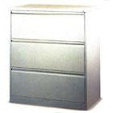
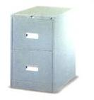
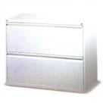
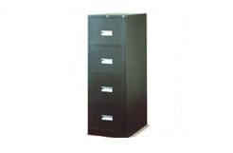
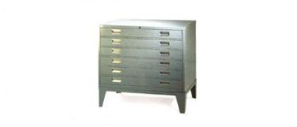
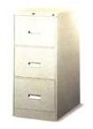
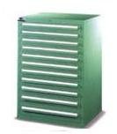
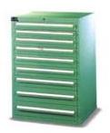
Cabinets

Slide 19
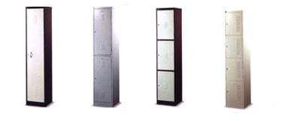
Lockers

Slide 20
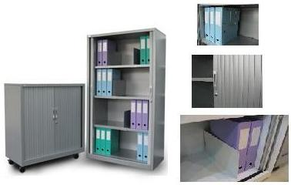
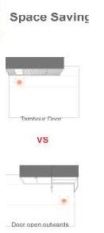
Tambour Door Cabinet

Slide 21
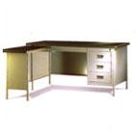
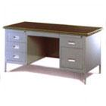
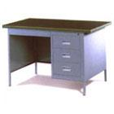
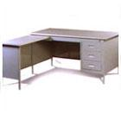
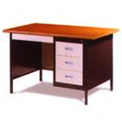
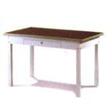
Tables

Slide 22
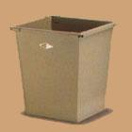
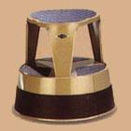
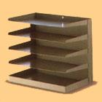
Others

Slide 23
Companies Served
Phil Seven Eleven
CDC Shoppes
Budget Mart
S. D. Platon
R.I. Nepomuceno construction
Ronald Llorente
Phil Pizza Inc.
Mini Stop
La Boutique
3L Phils
Petron
Maalab Design
Victory Quick Meals
First Allianz
Unilab
9.San Miguel Foodshop
Total (Phils) Corp.
11-16 construction
City State Hotels

Slide 24
Contact Details
Peter Daryl M. Isnit
Sales Engineer
0917-890-2876
peter@toic.com.ph

Slide 25
About TOIC
Established in 1976
Started supplying to Chevron in early 2000
Imported additives and chemicals
Lighting Systems Industries (LSI) Lighting
Fibrelite
Mid 2000s, started supplying MOEM Gondola store shelving
Awarded distributorship of Gilbarco in 2007
2008 began carrying Airtec
2010 Postec, Transtank and Leighton O’Brien and Nupi

Slide 26
Company Details
Office Address:
Unit 200A FUBC Bldg., 413 Escolta, Manila, Philippines 1006
(632) 241-5676 trunk line
(632) 243-5146 direct line
(632) 244-7271 fax
e-mail: info@toic.com.ph
Warehouse Address:
Old Sassari Building, Sta. Maria corner Teresita Drive, Bagong Bayan, Taguig
(+632) 837 0062
#1 Rolling Lane, Batasan Hills, Quezon City, Philippines
(+632) 931-5391
(+632) 430-6061
Operation Hours:
Office: 800hrs to 1800hrs
Warehouse: 24hrs
Type of Business: Import - Export
Type of Organization: Corporation
Years in Business: 39 years
Date Established: January 15, 1976
SEC Reg. Number: 65459
Number of Employees: 30
Affiliate Companies:
Trans-World International Logistics Corp.
Global Procurement Inc. (GPI)
Remec Broadband Wireless

Slide 27
TOIC’s Mission & Vision
MISSION
To provide the best quality products and support services for improved efficiency, client profits, savings, and to increase consumer preference, confidence and loyalty to our clients.
VISION
To establish a commanding presence in the Philippines as a total-solutions provider, and to be the preferred business partner of principals to carry their products and services.

